Slide 1
Introduction to Apache Hadoop

Slide 2

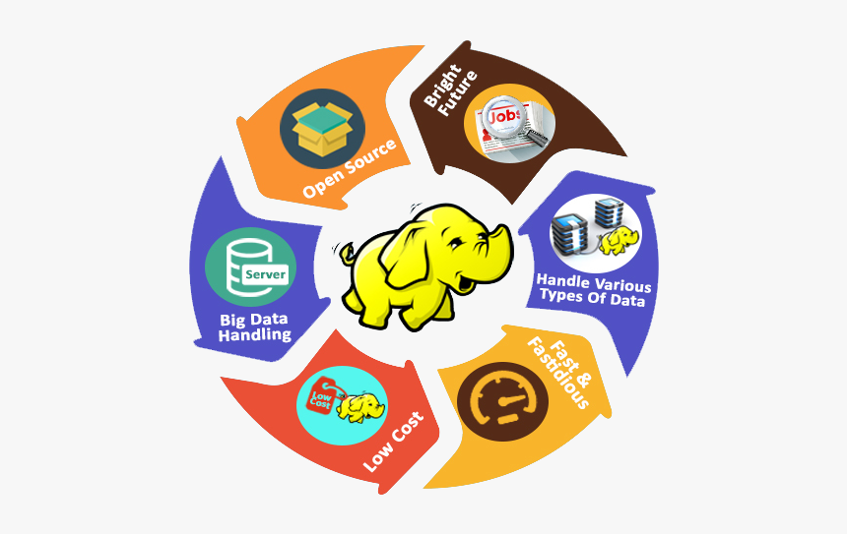
What is Hadoop
A framework for distributed processing of very large datasets on computer clusters
Processing means both storing and computing
Can scale up to thousands of machines
Who uses Hadoop? Many organizations, including many major ones
Amazon
Adobe
eBay
Facebook
Google
IBM
Full list and details at https://cwiki.apache.org/confluence/display/hadoop2/PoweredBy

Slide 3
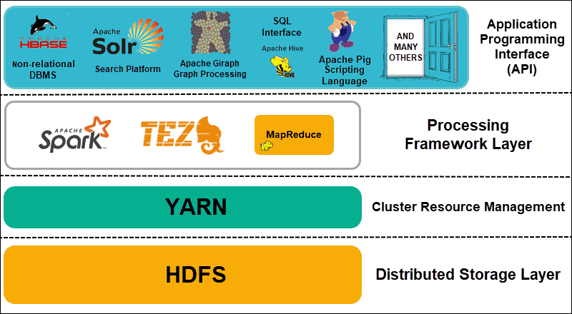
Hadoop Architecture
Distributed Storage
Hadoop Distributed File System (HDFS)
Data is split into blocks then stored in different nodes with their own resources
Master nodes keep metadata
Cluster Resource Management
Yet Another Resource Negotiator (YARN)
Coordinate nodes for data processing
Processing Framework
MapReduce, Spark
Process and analyze data
API
Various applications

Slide 4
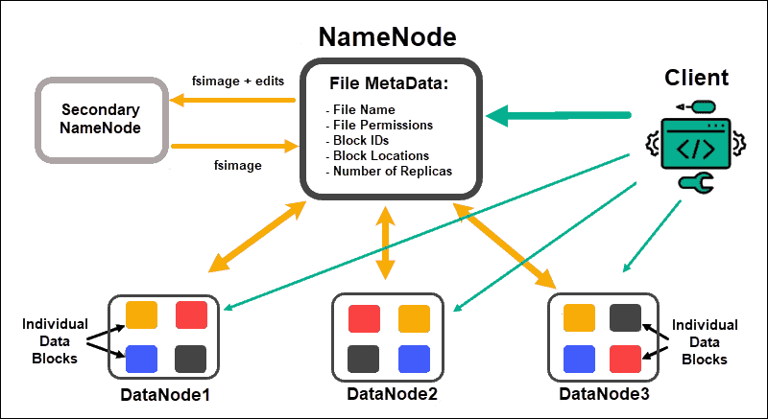
Hadoop Distributed File System - HDFS
Underlying file system for Hadoop clusters
Scalable, fault-tolerant, rack-aware
Designed to be deployed on commodity hardware
Each cluster typically has
A name node
A secondary name node
Data nodes
Data is split into blocks
Distributed in nodes in the cluster
Three copies are maintained at any times

Slide 5
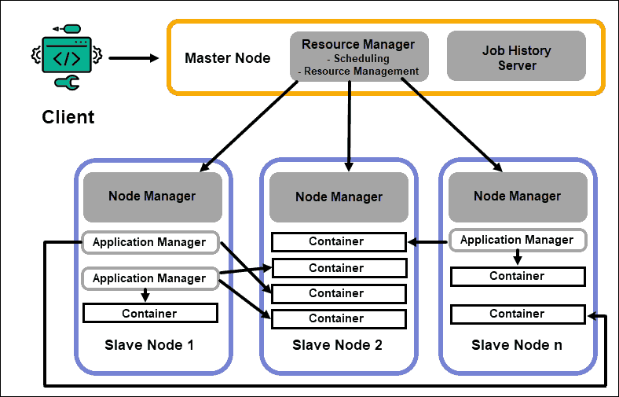
Yet Another Resource Negotiator - YARN
Placed in between the HDFS layer and the processing layer for resource management and allocation
Includes
Resource Manager – controls all resources in the cluster, placed on a dedicated master node
Node Manager – handles local services and storages, placed on data nodes
Application Manager, Container, Job History, etc.

Slide 6
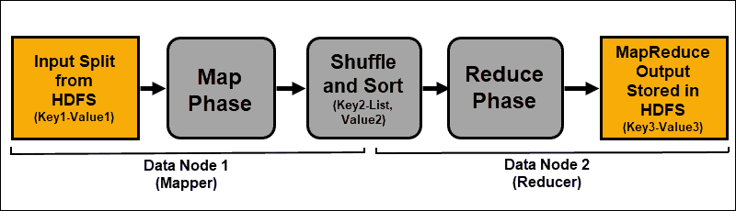
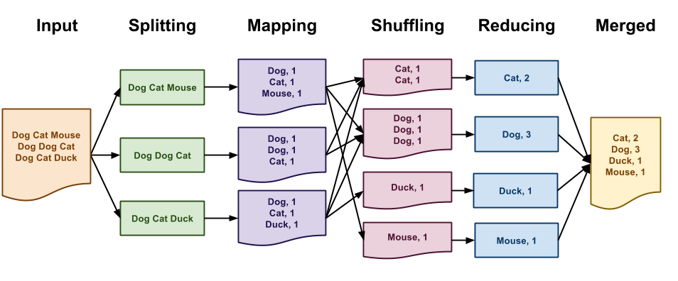
MapReduce
An algorithm that processes data dispersed across the Hadoop cluster
Includes a Mapper and a Reducer
Mapper: splits input data then map them into key-value pairs which are then grouped, partitioned, and shuffled to the reducers
Reducer: receives shuffled data from mapper, sorts, then generates new key-value pairs. Results are stored in HDFS

Slide 7
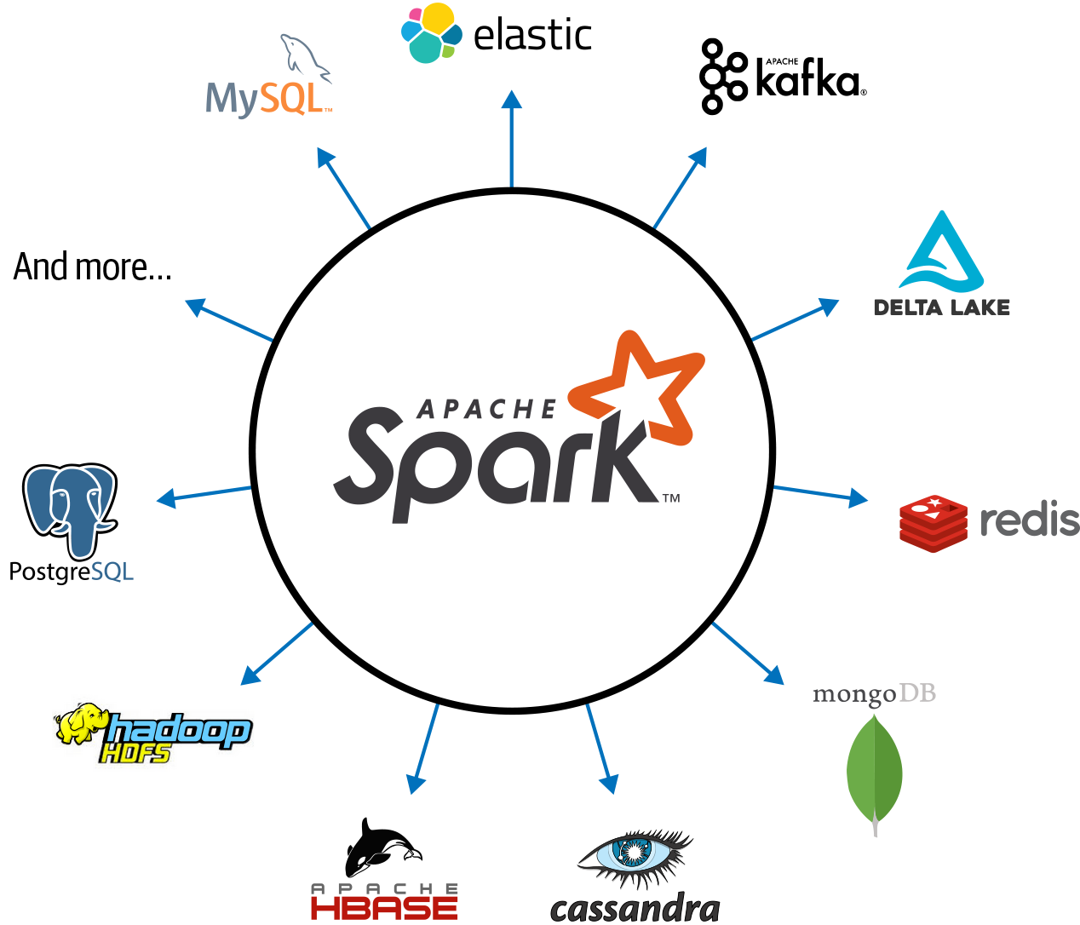
Spark
Multi-language engine for processing and analyzing data on single nodes or clusters
Runs on Hadoop clusters alone or with YARN
Compatible with the various data formats in Hadoop and other data systems
Over 1000 organizations are using Spark
https://spark.apache.org/powered-by.html

Slide 8
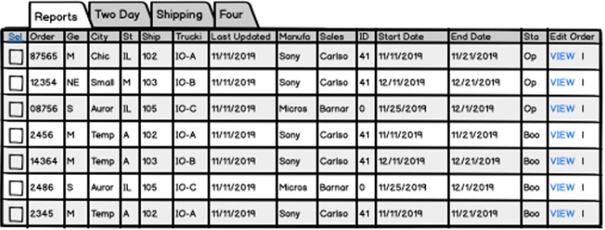
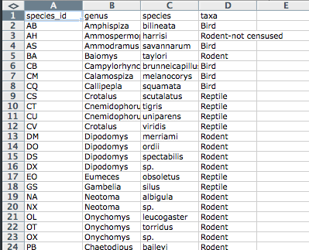
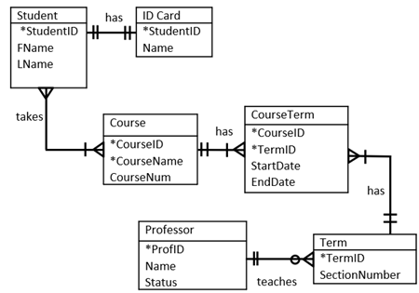
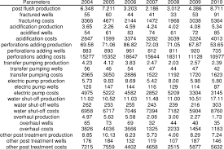
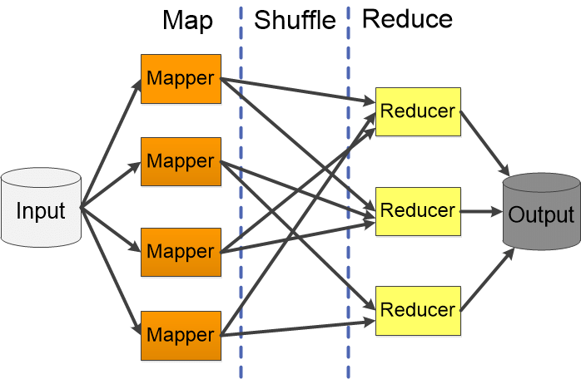
What Hadoop is not for
Relational databases
Hadoop stores data in files without indexing
MapReduce is used for data retrieval
SQL queries are not parts of the design
However, there are certain products that support table-column databases and SQL queries
MapReduce is for parallel processes, not sequential processes
Anything but the results is not available
HDFS
Stored
Not stored

Slide 9
Extra Reading
https://hadoop.apache.org/
https://cwiki.apache.org/confluence/display/hadoop2/PoweredBy
https://phoenixnap.com/kb/apache-hadoop-architecture-explained
https://hadoop.apache.org/docs/stable/hadoop-project-dist/hadoop-hdfs/HdfsDesign.html
https://cwiki.apache.org/confluence/display/HADOOP2/HadoopIsNot

